Slide 1



MERN – ES6 + React
Module 09: DOM Model

Slide 2
Outline
Module 09
DOM Model Understanding
Understanding of methods document.getElementById()
Understanding of methods document.getElementByClass Name()
Understanding of methods document.getElementsByTag Name()
Understanding of methods document.querySelector()
Understanding of methods document.querySelectorAll()

Slide 3
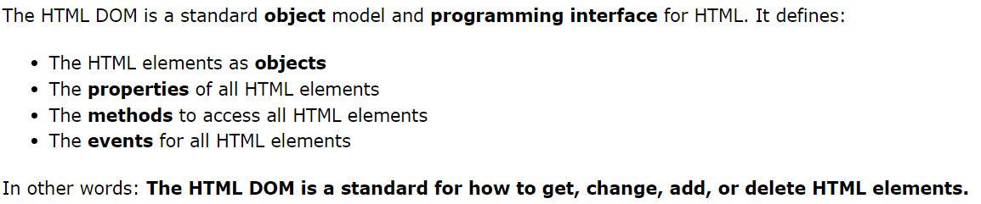
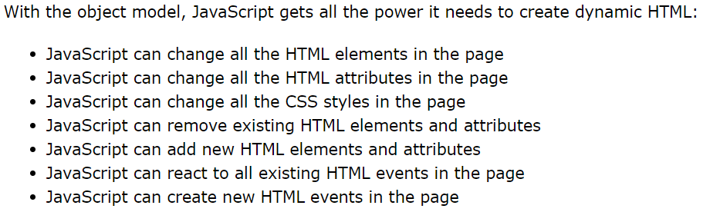

JavaScript HTML DOM
With the HTML DOM, JavaScript can access and change all the elements of an HTML document.

Slide 4
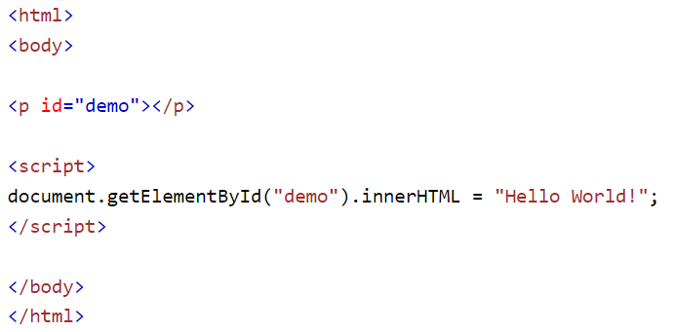
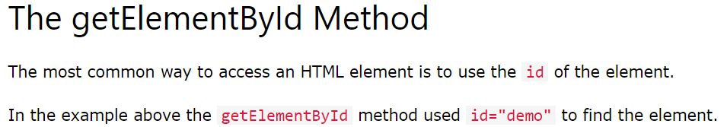
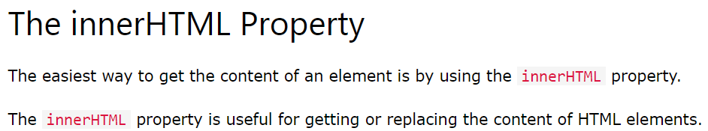
The DOM Programming Interface
JavaScript HTML DOM

Slide 5
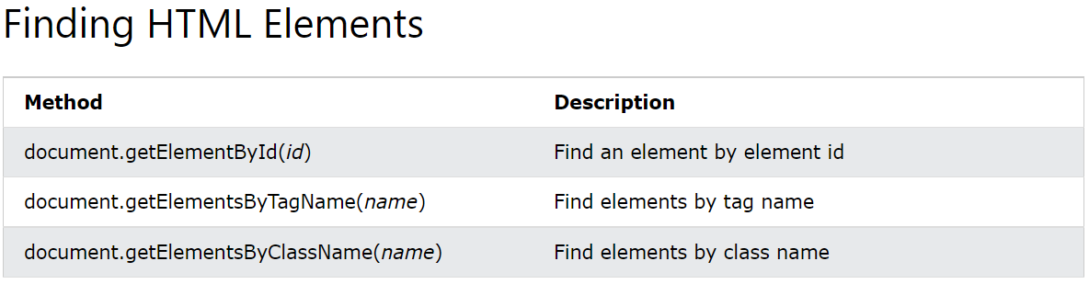
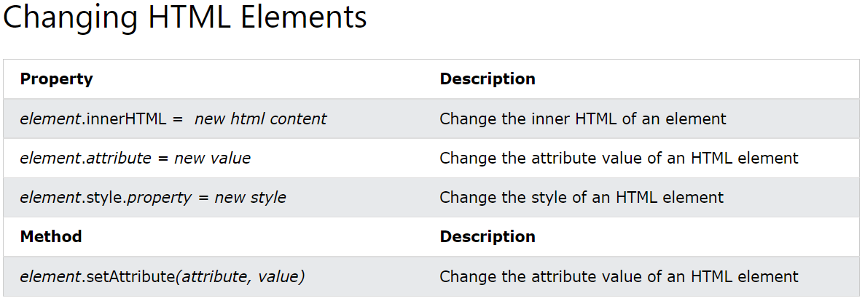
The DOM Programming Interface
The HTML DOM document object is the owner of all other objects in your web page.

Slide 6
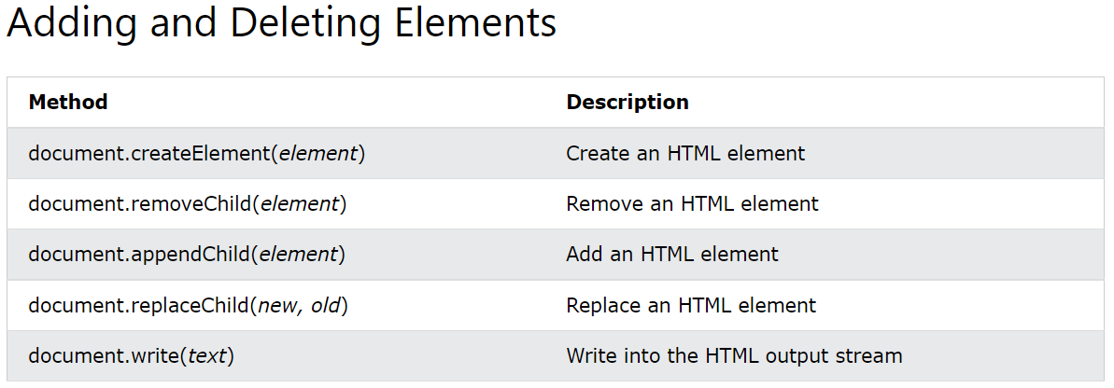
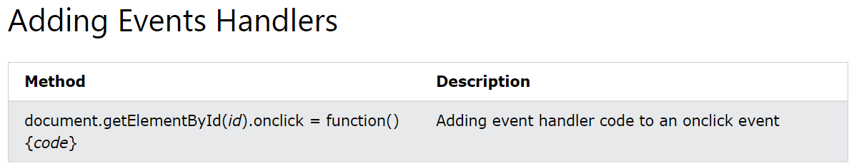
The DOM Programming Interface
The HTML DOM document object is the owner of all other objects in your web page.

Slide 7
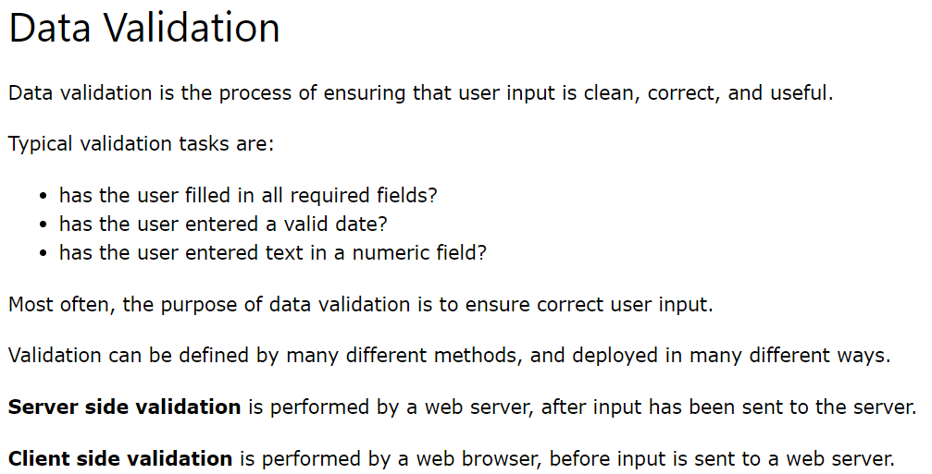
JavaScript Form Validation
JavaScript HTML DOM
Example 1
Example 2
Example 3

Slide 8
Changing HTML Style
JavaScript HTML DOM
Changing HTML Style
The HTML DOM allows JavaScript to change the style of HTML elements.
Example 1
Example 2
Example 3

Slide 9
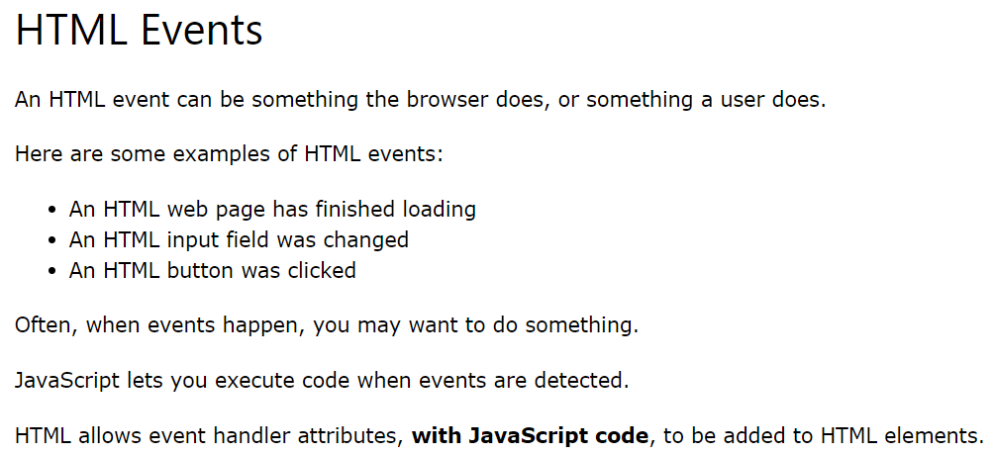
JavaScript Events
JavaScript basics
Example

Slide 10
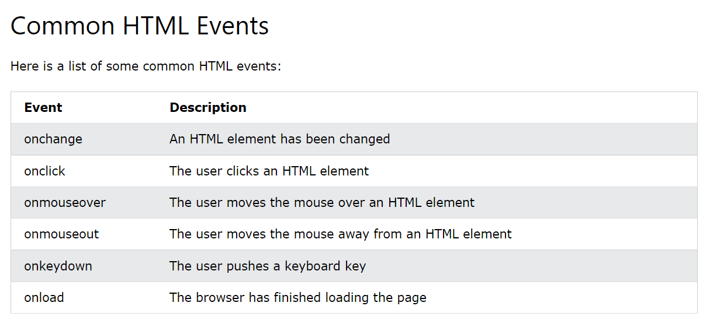
JavaScript Events
JavaScript basics
Example 1
Example 2
Example 3

Slide 11
Web APIs

Slide 12
What is Web API?
A Web API is a developer's dream.
API stands for Application Programming Interface.
A Web API is an application programming interface for the Web.
A Browser API can extend the functionality of a web browser.
A Server API can extend the functionality of a web server.
Third party APIs are not built into your browser. To use these APIs, you will have to download the code from the Web.

Slide 13
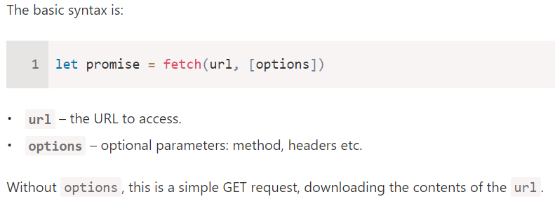
JavaScript Fetch API
The Fetch API interface allows web browser to make HTTP requests to web servers.
Example

Slide 14
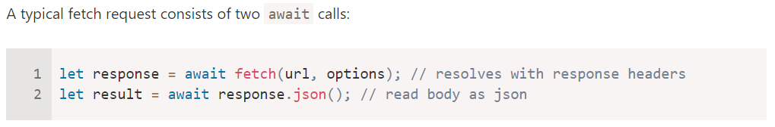
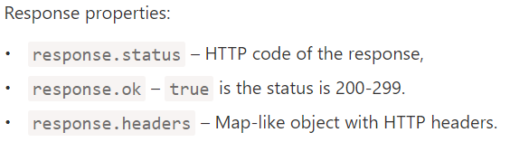
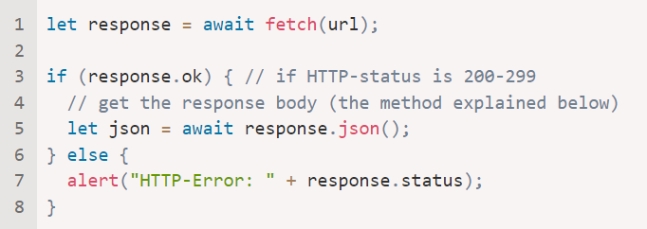
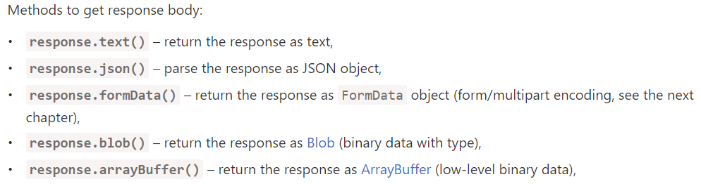
JavaScript Fetch API (GET)
The Fetch API interface allows web browser to make HTTP requests to web servers.

Slide 15
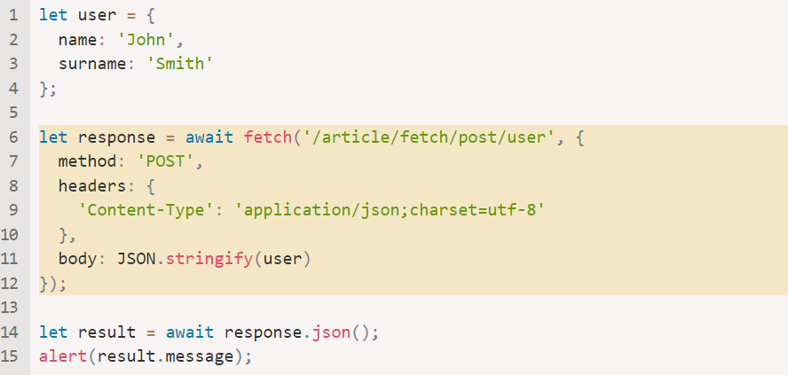
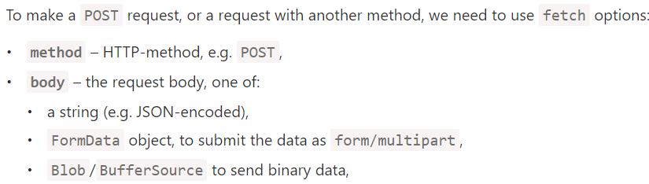
JavaScript Fetch API (POST)
The Fetch API interface allows web browser to make HTTP requests to web servers.
Fetch (javascript.info)

Slide 16
Summary
Module 09
DOM Model Understanding
Understanding of methods document.getElementById()
Understanding of methods document.getElementByClass Name()
Understanding of methods document.getElementsByTag Name()
Understanding of methods document.querySelector()
Understanding of methods document.querySelectorAll()

